Slide 1
What is XMPP?
eXtensible Messaging and Presence Protocol
Bi-directional streaming XML
Core: IETF RFC 6120, 7590, 6121
Extensions: XMPP Standards Foundation (XSF)
  Membership-based
  Elected technical council
  Unit of work: XMPP Extension Protocol (XEP)
  Process: Experimental, Proposed, Draft, Final
Goals:
  Simple clients
  Federate everything

Slide 2
What is XMPP ?
X : It means eXtensible. XMPP is an open-source project which can be changed or extended according to the need.
M : XMPP is designed for sending messages in real time. It has very efficient push mechanism compared to other protocols.
P : It determines whether you are online/offline/busy. It indicates the state.
P : XMPP is a protocol, that is, a set of standards that allow systems to communicate with each other.

Slide 3
Basic requirements of any Instant Messenger which are fulfilled by XMPP
Send and receive messages with other users.
Check and share presence status
Manage subscriptions to and from other users.
Manage contact list
Block communications(receive message, sharing presence status, etc) to specific users.
Decentralized. Based on client-server architecture.
Publish-Subscribe model.

Slide 4
What is XMPP ?
The eXtensible Messaging and Presence Protocol (XMPP) is a TCP communications protocol based on XML that enables near-real-time exchange of structured data between two or more connected entities.
Out-of-the-box features of XMPP include presence information and contact list maintenance.
Due in part to its open nature and XML foundation, XMPP has been extended for use in publish-subscribe systems.
Used by applications like WhatsApp, Kik Messenger, Zoom, etc. for managing contact list, online presence, etc.

Slide 5
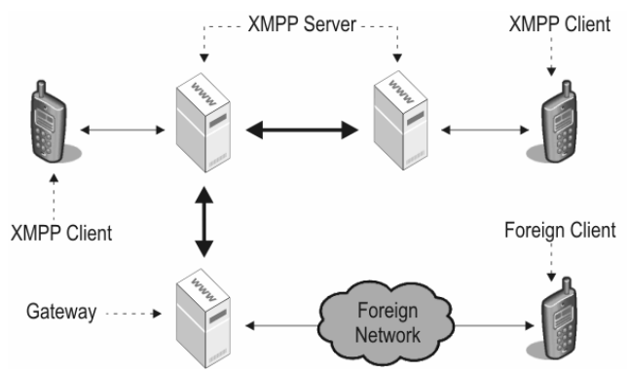
XMPP Core Architecture

Slide 6
XMPP Architecture
Client
Client
Server1
Server2
Client
Client
Client
Client
Server3
Client
Client
Client
Server<->Server: Port 5269
Client<->Server: Port 5222

Slide 7
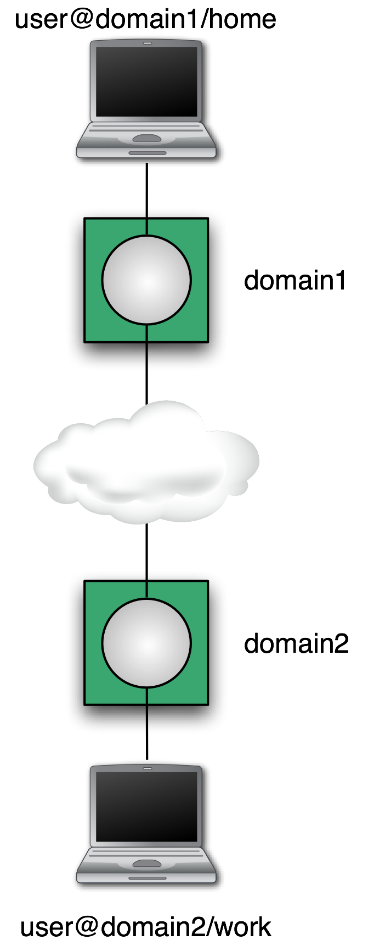
XMPP Architecture
Addressing Scheme: node@domain/resource
  JID = Jabber ID
  Node: identity, e.g. user name
  Domain: DNS domain name
  Resource: device identifier
  node@domain identifies a person
Client talks to “local” server
  Wherever the user account is hosted
  Tied to directory if desired
  Organizational policy enforced
Servers talk to other servers
  DNS lookup on domain portion of address
  Dialback, MTLS for security
  One connection for many conversations
Notes:
The basic idea behind Server Dialback is that a receiving server does not accept XMPP traffic from a sending server until it has (a) "called back" the authoritative server for the domain asserted by the sending server and (b) verified that the sending server is truly authorized to generate XMPP traffic for that domain.
Multiplexed Transport Layer Security (MTLS) protocol is a new TLS sub-protocol running over TLS or DTLS. The MTLS design provides application multiplexing over a single TLS (or DTLS) session. Therefore, instead of associating a TLS connection with each application, MTLS allows several applications to protect their exchanges over a single TLS session.

Slide 8
XMPP Architecture
Each XMPP client is identified by JID (Jabber ID).
#JID { user, server, resource }
example, a WhatsApp user and identified by mobile number is represented as,
user = “9833191909" server = "whatsapp.com" resource = "mobile"
JID : " 9833191909@whatsapp.com/mobile"
Notes:
The basic idea behind Server Dialback is that a receiving server does not accept XMPP traffic from a sending server until it has (a) "called back" the authoritative server for the domain asserted by the sending server and (b) verified that the sending server is truly authorized to generate XMPP traffic for that domain.
Multiplexed Transport Layer Security (MTLS) protocol is a new TLS sub-protocol running over TLS or DTLS. The MTLS design provides application multiplexing over a single TLS (or DTLS) session. Therefore, instead of associating a TLS connection with each application, MTLS allows several applications to protect their exchanges over a single TLS session.

Slide 9
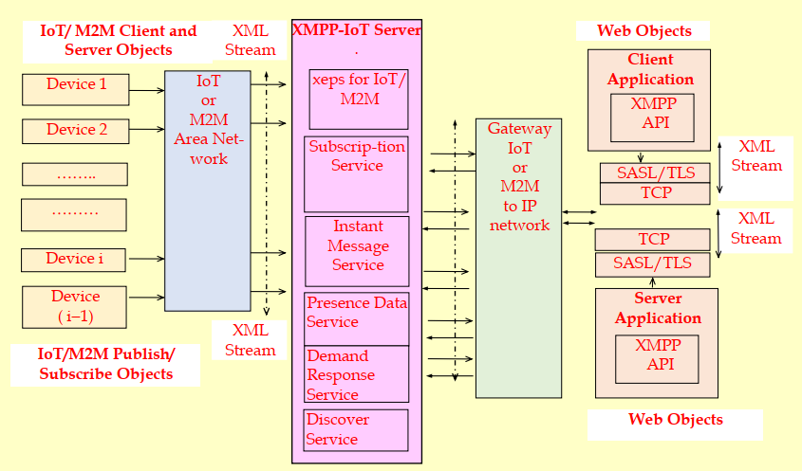
XMPP Architecture
Notes:
The basic idea behind Server Dialback is that a receiving server does not accept XMPP traffic from a sending server until it has (a) "called back" the authoritative server for the domain asserted by the sending server and (b) verified that the sending server is truly authorized to generate XMPP traffic for that domain.
Multiplexed Transport Layer Security (MTLS) protocol is a new TLS sub-protocol running over TLS or DTLS. The MTLS design provides application multiplexing over a single TLS (or DTLS) session. Therefore, instead of associating a TLS connection with each application, MTLS allows several applications to protect their exchanges over a single TLS session.

Slide 10
What is XML
  XML is a simple tag-based language for describing information in a structured way.
  Basic elements:
  Tags
  Attributes
  Text
LastName
Allen
StartTag
Attributes
Text
EndTag
<xhtml:table><xhtml:tr>
<xhtml:td width="40%">LastName</xhtml:td>
<xhtml:td width="60%">Allen</xhtml:td>
</xhtml:tr></xhtml:table>

Slide 11
How to work on XML
The tree-like structure of XML makes developers life hard.
  In practice there is not a standard way for editing and analyzing, but the best method depends on your need. Just choose among:
  SAX -> callback-based parser
  DOM -> tree representation
  XSLT -> “XML to XML” conversion
  XPATH -> queries
  XML Binding -> transparent conversion to objects

Slide 12
Example of an XML message
<SensorTemp ID = ‘250715’ TimeDate = ‘19:28:33 Jul 17 2015’> 22 </SensorTemp>
Java or C++ or other language parser reads the XML and finds that sensor of ID = 250715 had T = 22 C on 17.07.2015 at 19:28:33

Slide 13
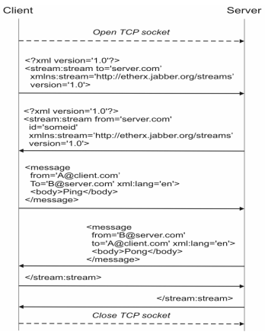
XMPP Streams
Instead of delivering separate XML documents on a single connection, a persistent connection is used for delivering the XML data elements
The message stanza is used a push mechanism from one entity to another

Slide 14
XMPP Streams
Client connects TCP socket to server
Client sends stream start tag:
<stream:stream xmlns='jabber:client'
xmlns:stream='http://etherx.jabber.org/streams'
to='example.com'
version='1.0'>
Server sends stream start tag back:
<stream:stream xmlns='jabber:client'
xmlns:stream='http://etherx.jabber.org/streams'
from='example.com’
id='someid'
version='1.0'>
Each child element of stream: a “stanza”

Slide 15
Stream features
After stream start, server sends feature list:
<stream:features>
<starttls xmlns='urn:ietf:params:xml:ns:xmpp-tls'/>
<mechanisms xmlns='urn:ietf:params:xml:ns:xmpp-sasl'>
<mechanism>DIGEST-MD5</mechanism>
</mechanisms>
<compression xmlns='http://jabber.org/features/compress'>
<method>zlib</method>
</compression>
</stream:features>
Client can negotiate any of these features

Slide 16
Stream features
Presence stanza is the notification part of the basic publish-subscribe mechanism; it is used to deliver information from one entity to multiple recipients.
IQ (Info/Query) is a request-response interaction, with which an entity is able to request some information from another entity.

Slide 17
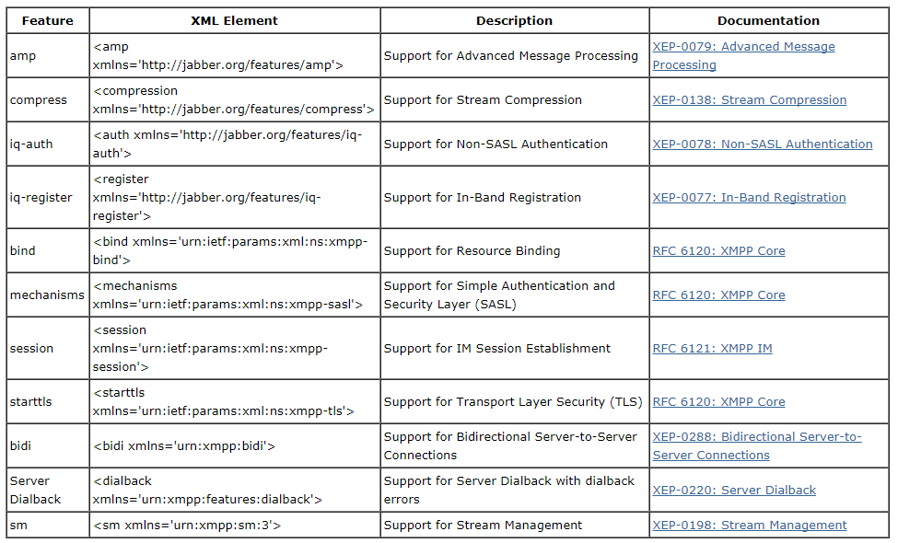
XML Stream Features

Slide 18
Presence Stanzas Example
<presence xml:lang='en'>
<show>dnd</show>
<status>Having a coffee break</status>
<status xml:lang='fi'>Kahvitauolla</status>
<priority>1</priority>
</presence>

Slide 19
Security Stuff
Start-TLS
  Prove the identity of the server
  Prove the identity of the user (optional)
  Encryption
  Data integrity
SASL(Simple Authentication and Security Layer protocol) (RFC 4422)
  Authentication
  Optional encryption (rarely used)
  Pluggable (e.g. passwords, Kerberos, X.509, SAML, etc.)

Slide 20
Stanzas
All have to='JID' and from='JID' addresses
  To gives destination
  From added by local server
Each stanza routed separately
All contents of stanza passed along
Extend with any XML from your namespace
Different types for delivery semantics
  <message/>: one direction, one recipient
  <presence/>: one direction, publish to many
  <iq/>: "info/query", request/response
See details next page

Slide 21
Presence
express an entity's current network availability
Example:
<presence>
<show>dnd</show>
<status>Meeting</status>
<priority>1</priority>
</presence>
Show: chat, available, away, xa, dnd
Status: Human-readable text
Priority: Which resource "most available"?

Slide 22
IQ Request
a structured request-response mechanism
Example:
<iq type='get'
id='roster_1'>
<query xmlns='jabber:iq:roster'/>
</iq>
Type: get, set, result, error
ID: track the corresponding response
Query/Namespace: what type of request?

Slide 23
IQ Response (Roster)
Example:
<iq type='result'
id='roster_1'>
<query xmlns='jabber:iq:roster'>
<item jid='romeo@example.net'
name='Romeo'
subscription='both'>
<group>Friends</group>
</item>
</query>
</iq>
Type: response
ID matches request
Subscription state: none, to, from, both

Slide 24
Subscribing to Presence
Send a subscription request:
<presence to='juliet@example.com'
type='subscribe'/>
Approving a request:
<presence to='romeo@example.net'
type='subscribed'/>
Every time you change a subscription, you get a
"roster push":
<iq type='set'>
<query xmlns='jabber:iq:roster'>
<item jid='romeo@example.net'
subscription='from'/>
</query>
</iq>

Slide 25
Extensibility Example: Message
Use a new namespace
Key: if you don't understand it, ignore it
Example, CAP, XEP-0127:
<message to='weatherbot@jabber.org'
from='KSTO@NWS.NOAA.GOV'>
<alert xmlns='http://www.incident.com/cap/1.0'>
<identifier>KSTO1055887203</identifier>
<sent>2003-06-17T14:57:00-07:00</sent>
<info>
<category>Met</category>
<event>SEVERE THUNDERSTORM</event>
...
</info>
</alert>
</message>
Common Alerting Protocol (CAP) Over XMPP

Slide 26
Extensibility Example: Presence
Keep presence stanzas small
Example: Entity Capabilities, XEP-0115:
<presence from='bard@shakespeare.lit/globe'>
<c xmlns='http://jabber.org/protocol/caps'
hash='sha-1'
node='http://www.chatopus.com'
ver='zHyEOgxTrkpSdGcQKH8EFPLsriY='/>
</presence>
Ver attribute is hash of all features of this client
Hash -> Feature list is cached
It defines an XMPP protocol extension for broadcasting and dynamically discovering client, device, or generic entity capabilities.

Slide 27
Bandwidth minimization
TLS compression
  Not implemented in all SSL/TLS stacks
  Some want compression w/o encryption
XEP-0138: Stream Compression
  Defines zlib mechanism (2-3x or more compression)
  Others can be added
  Concern: battery drain vs. radio transmission
XEP-0198: Stanza Acknowledgements
  Quick reconnects
  Avoid re-synchronizing state on startup
Partial rosters
Privacy lists
Others being pursued

Slide 28
Latency
Most critical on startup
  Several handshakes and stream restarts
  Can be minimized by client assuming server configuration
  Example: don't wait for <stream:features>
Once running
  Stanza size matters: try to stay under 8kB,
  take larger blocks out of band if possible
  Configure federation to keep links open,
  first stanza will be slow
  Beware of DoS protection, "karma"
Notes:
KARMA is a set of tools for assessing the security of wireless clients at multiple layers. Wireless sniffing tools discover clients and their preferred/trusted networks by passively listening for 802.11 Probe Request frames. From there, individual clients can be targetted by creating a Rogue AP for one of their probed networks (which they may join automatically) or using a custom driver that responds to probes and association requests for any SSID. Higher-level fake services can then capture credentials or exploit client-side vulnerabilities on the host.
KARMA includes patches for the Linux MADWifi driver to allow the creation of an 802.11 Access Point that responds to any probed SSID. So if a client looks for ‘linksys’, it is ‘linksys’ to them (even while it may be ‘tmobile’ to someone else). Operating in this fashion has revealed vulnerabilities in how Windows XP and MacOS X look for networks, so clients may join even if their preferred networks list is empty.
KARMA stands for Karma Attacks Radio Machines Automatically. A radio machine could simply be a smart-phone, tablet, laptop or any wi-fi enabled device. It is a man-in-the-middle attack that it creates a rough AP and attacker could intercept all the traffic passing from the AP.

Slide 29
Advantages of XMPP
The primary advantage is XMPP's decentralized nature.
XMPP works similar to email, operating across a distributed network of transfer agents rather than relying on a single, central server or broker (as CoAP and MQTT do).
As with email, it’s easy for anyone to run their own XMPP server, allowing device manufacturers and API operators to create and manage their own network of devices.
And because anyone can run their own server, if security is required, that server could be isolated on a company intranet behind secure authentication protocols using built-in TLS encryption.

Slide 30
Disadvantages of XMPP
One of the largest flaws is the lack of end-to-end encryption. While there are many use cases in which encryption may not yet be necessary, most IoT devices will ultimately need it. The lack of end-to-end encryption is a major downside for IoT manufacturers.
  https://wiki.xmpp.org/web/XMPP_E2E_Security
Another downside is the lack of Quality of Service (QoS). Making sure that messages are delivered is even more important in the IoT world than it was in the instant messaging world. If your alarm system doesn’t receive the message to turn itself on, then that vacation you’ve been planning could easily be ruined.

